Slide 1
Intro to PyCharm
Brandon Krakowsky

Slide 2
Intro to PyCharm

Slide 3
PyCharm
PyCharm is an integrated development environment for Python development
It’s developed by JetBrains
PyCharm has A LOT of features including, but not limited to:
Code assistance and analysis
Code completion
Syntax and error highlighting
Quick fixes

Slide 4

Downloading PyCharm
To use the free, open-source version of PyCharm, download the “Community” version
URL: https://www.jetbrains.com/pycharm/download/

Slide 5
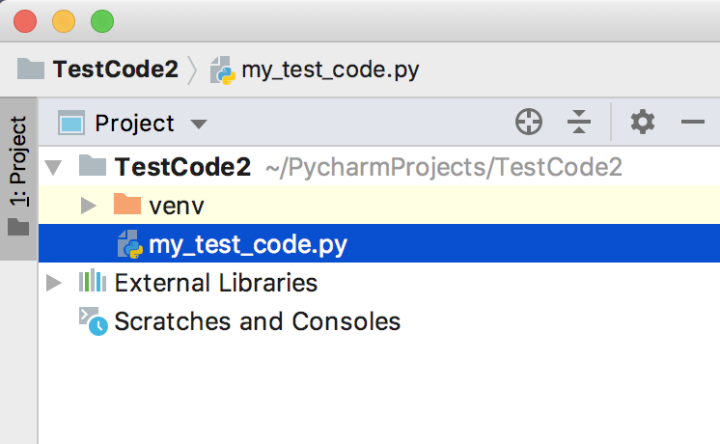
Using PyCharm
Start by creating a “Project” and create Python files within that project
You’ll see your project and files in the Project navigator to the left

Slide 6
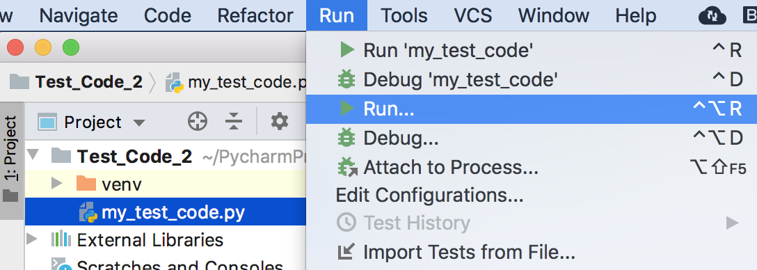
Using PyCharm – Running Code
To run a script, use the keyboard shortcut CTRL + OPTION + R
Or go to Run → Run

Slide 7
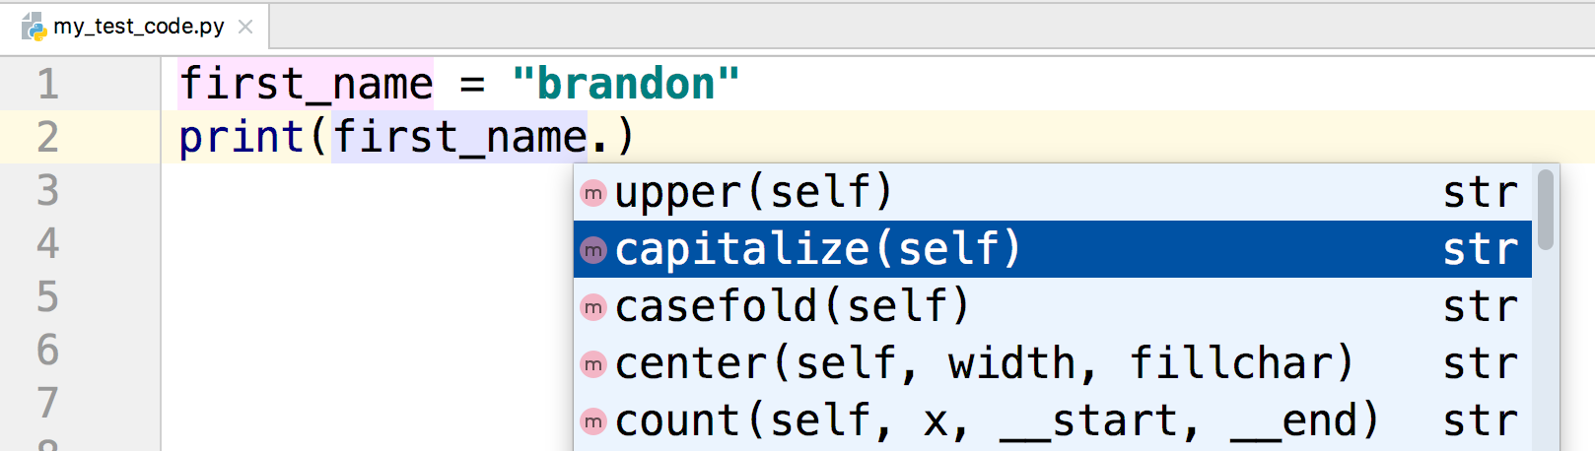
Using PyCharm – Code Lookup
Let’s say you have a string that you want to capitalize
Typing a period at the end of the string will automatically bring up a code lookup window with all of the available built-in string variables and methods
What does capitalize() do?

Slide 8
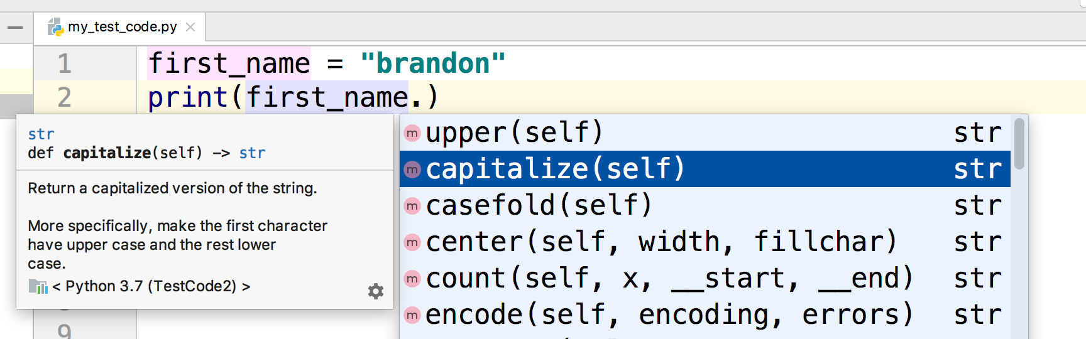
Using PyCharm – Code Lookup
Pressing F1 (on Mac) or Ctrl + Q (on Windows) will bring up documentation about each variable or function
The capitalize() function returns a capitalized version of the string

Slide 9
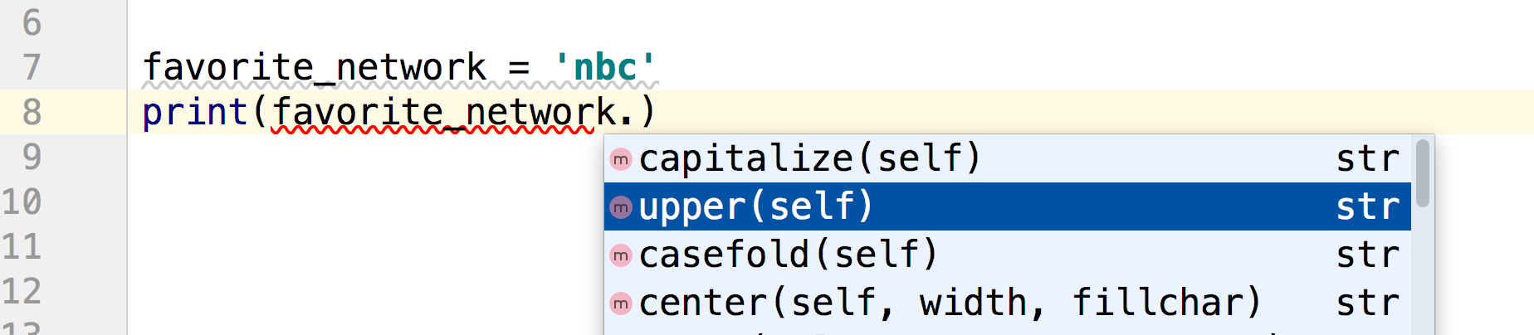
Using PyCharm – Code Lookup
Let’s say you have a string that you want to make uppercase
If I type a period at the end of the string I see upper()

Slide 10
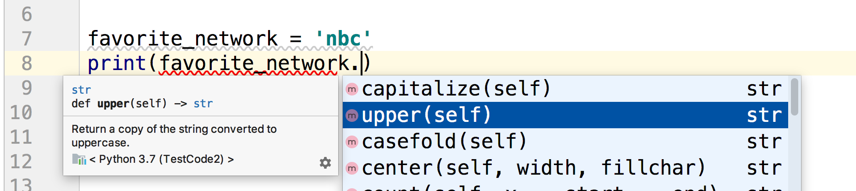
Using PyCharm – Code Lookup
If I press F1 (on Mac) or Ctrl + Q (on Windows) I see that upper() returns a copy of the string converted to uppercase

Slide 11
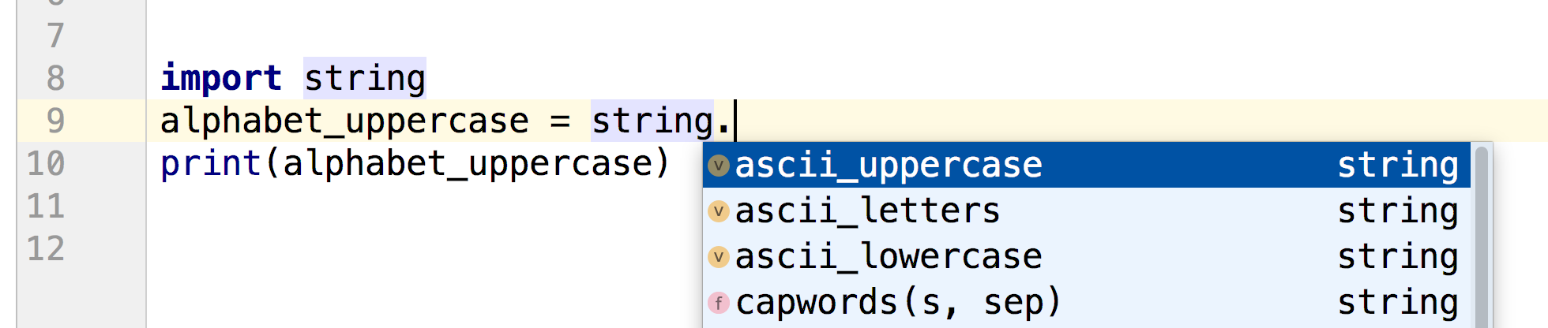
Using PyCharm – Code Lookup
Is there a way to get the letters in the alphabet as an uppercase list or string?
After I import string I can type a period after “string”
The code lookup window brings up ascii_uppercase

Slide 12
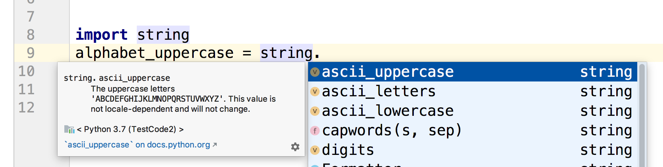
Using PyCharm – Code Lookup
Pressing F1 (on Mac) or Ctrl + Q (on Windows) shows me that ascii_uppercase stores all uppercase letters

Slide 13
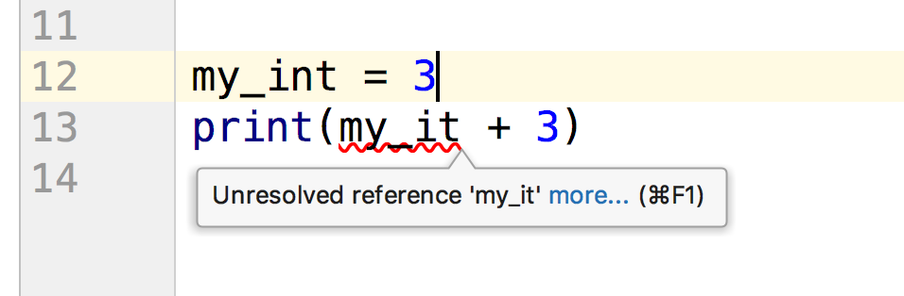
Using PyCharm – Warnings & Errors
Erroneous code is underlined with a red curvy line
If you hover your mouse pointer over the curvy line, detailed information about the error appears as a tooltip

